Slide 1

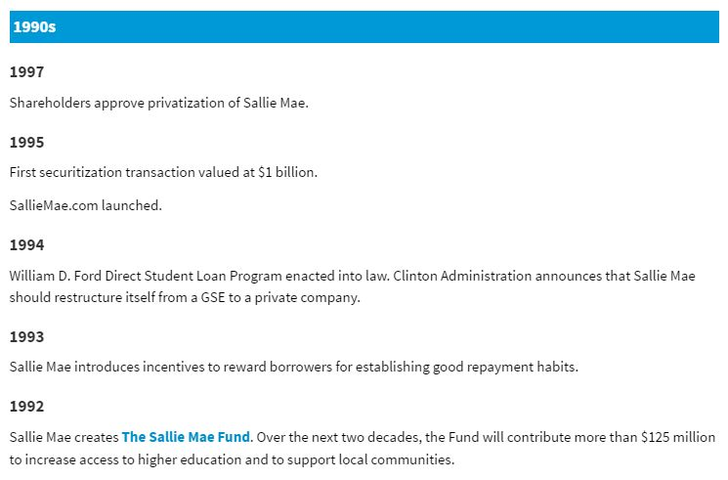
Supported two products no longer in service: PortSS and Laureate
PortSS was software used by lending institutions to support in-house student loan operations
Laureate was an online portal used by students and college financial aid administrators to apply and track student loans

Slide 3

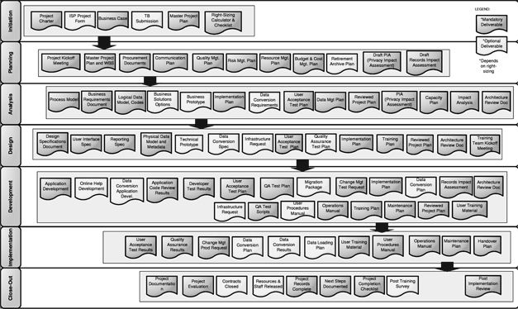
eCommerce Group
Defined and developed a process for the business unit to create and document requirements for website development, that would feed into the company’s overall development process and planning ; a self created Product Management Process before the group had product managers

Slide 4
eCommerce Group

Slide 5
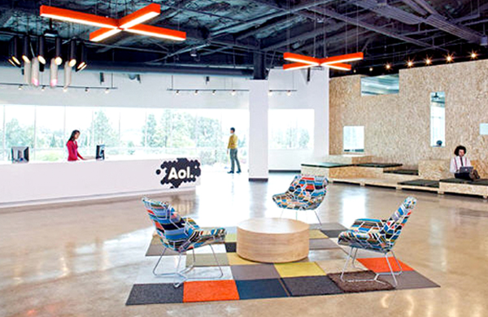
Provided Studio of 50+ designers a predictable process that would allow project managers to plan the Design phase of large software development projects.

Slide 6
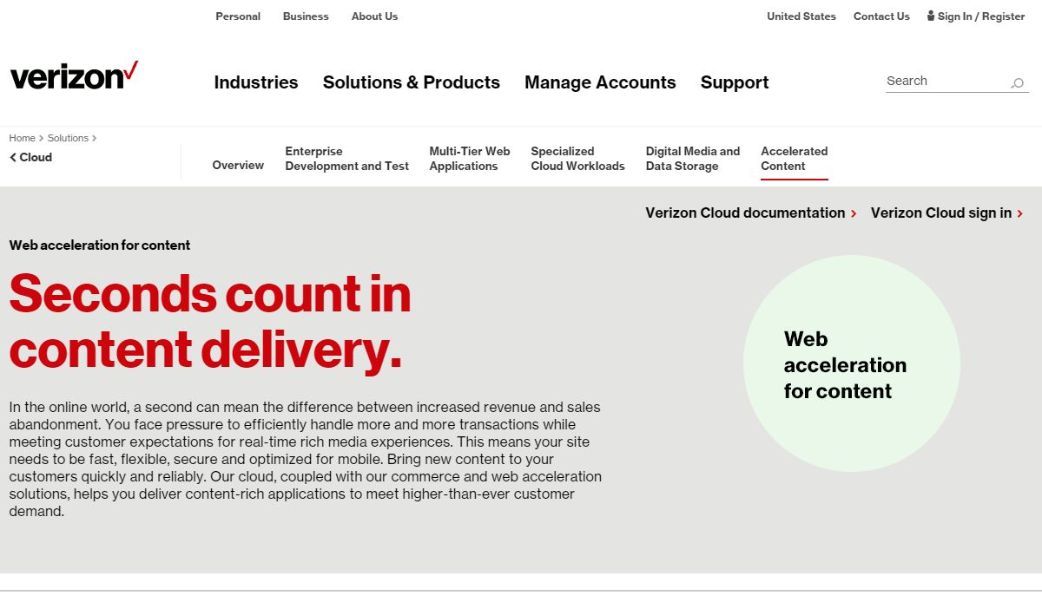
Provided 4 layers of service: Product management, Program management, General management, and Consulting

Slide 7
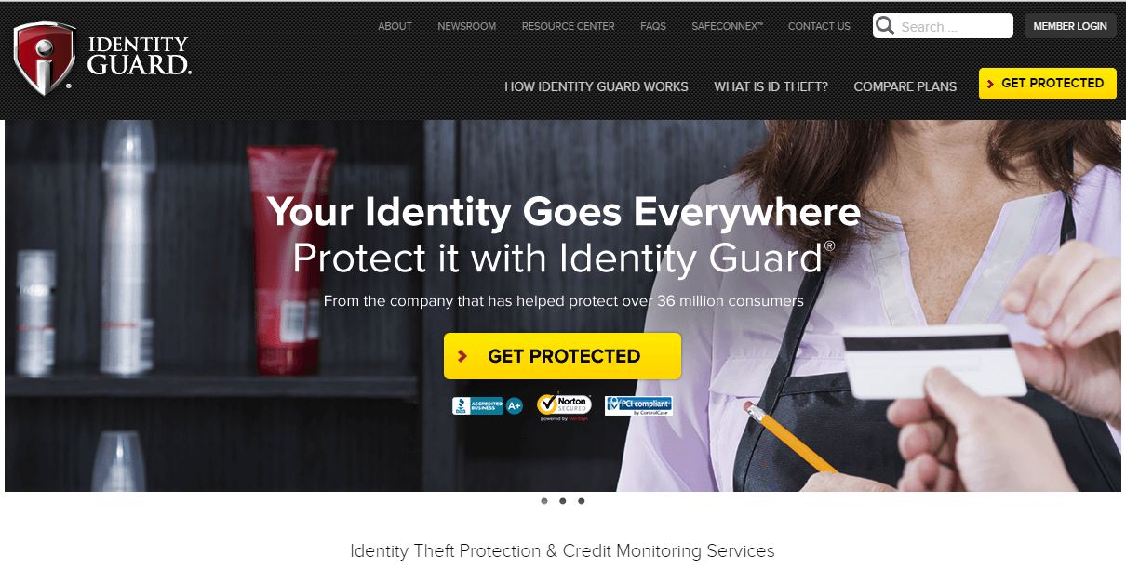
Managed all internet based projects including the launch of the first 3 in 1 credit report online.

Slide 8
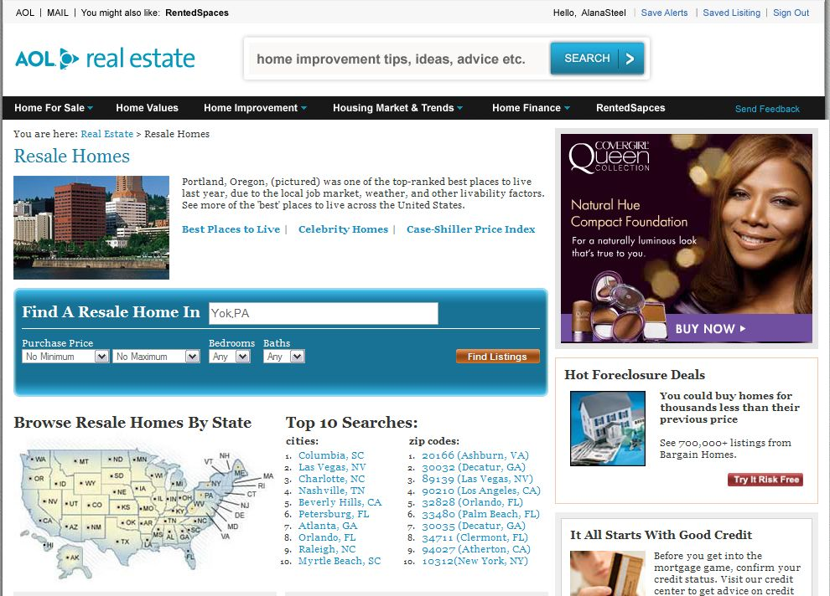
Led not one, but two full site redesigns supporting a complete change of business model and content strategy. Also, negotiated several deals from content providers.

Slide 9
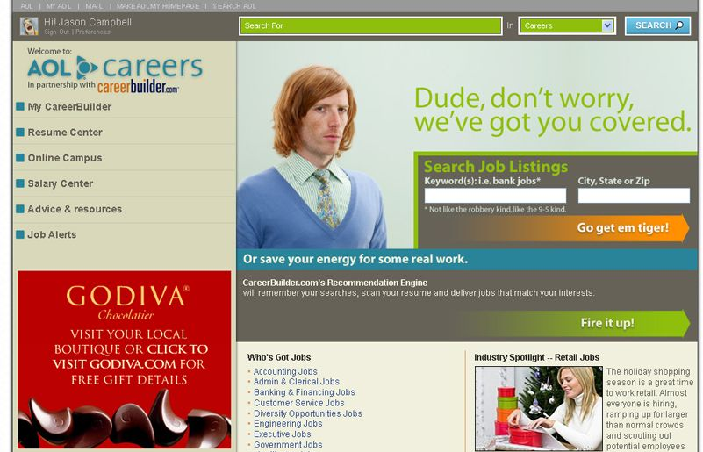
Guided business through market analysis and ideation for redesigning overall experience to include several new features that would ultimately broaden the scope of brand.

Slide 10
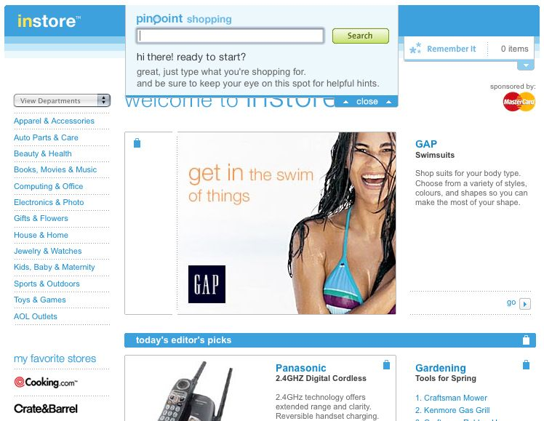
Simultaneously served in three roles: Program manager, matrixed Project manager and Product manager; leading eCommerce redesign project, plus development of a new content management and publishing system.

